Slide 1
Presented by: Shrey Bechara GID: 158312
Microcontroller Basics

Slide 2
Clock
A clock in a microcontroller is an electronic component that generates a series of pulses at a fixed frequency, which are used to synchronize the operation of the microcontroller and its peripherals. The clock is typically generated by a crystal oscillator or an RC circuit, and its frequency is usually measured in megahertz (MHz) or kilohertz (kHz).
The clock signal is used by the microcontroller to synchronize the execution of instructions and the operation of peripherals such as timers, serial ports, and analog-to-digital converters. The clock frequency determines the speed at which the microcontroller operates, and higher clock frequencies generally result in faster processing speeds.

Slide 3
Clock prescalers vs dividers
Clock prescalers divide the clock frequency by a fixed integer value, while clock dividers divide the clock frequency by a variable integer value. Both are useful in microcontroller design to generate clock signals for peripherals and subsystems with different clock requirements.

Slide 4
Understand Clock architecture of stm32L4 controller
The clock architecture of the STM32L4 controller includes several clock sources and a variety of clock prescalers and dividers that allow the user to generate the desired clock frequencies for the MCU and its peripherals. Here are the main components of the clock architecture:
High-speed external clock (HSE): The HSE is an external clock source that can be connected to the MCU's OSC_IN pin. The frequency of the HSE can be up to 80 MHz.
Internal high-speed clock (HSI): The HSI is an internal clock source that is always available, and its frequency is 16 MHz.

Slide 5
Low-speed external clock (LSE): The LSE is an external clock source that can be connected to the MCU's OSC32_IN pin. The frequency of the LSE can be 32.768 kHz.
Internal low-speed clock (LSI): The LSI is an internal clock source that is always available, and its frequency is 32 kHz.
PLL (Phase-Locked Loop): The PLL is a clock multiplier that can be used to generate higher-frequency clocks from the HSI or HSE clocks. The PLL can be configured to multiply the input frequency by a factor of 2 to 16.
Clock prescalers and dividers: The MCU includes several clock prescalers and dividers that can be used to divide down the frequency of the system clock and generate clock signals for the MCU's peripherals. These include the APB1 and APB2 prescalers, which can divide the clock frequency by factors of 1, 2, 4, or 8, and the AHB prescaler, which can divide the clock frequency by factors of 1, 2, 4, 8, 16, 32, 64, 128, or 256.

Slide 6
Types of Memory used in Microcontroller.
Microcontrollers use several types of memory to store program code, data, and configuration information. The most common types of memory used in microcontrollers are:
Flash memory: This is a type of non-volatile memory that is used to store the microcontroller's program code. Flash memory is typically organized into memory sectors that can be independently erased and programmed. In many microcontrollers, flash memory is also used to store configuration data and firmware updates.
SRAM (Static Random Access Memory): This is a type of volatile memory that is used to store data during program execution. SRAM is typically faster than other types of memory, but it requires power to maintain the stored data. When power is lost, the contents of SRAM are lost.
EEPROM (Electrically Erasable Programmable Read-Only Memory): This is a type of non-volatile memory that is used to store data that needs to be retained when power is turned off. EEPROM can be programmed and erased electrically, and it is typically slower than flash memory.

Slide 7
ROM (Read-Only Memory): This is a type of non-volatile memory that is used to store program code or data that cannot be changed. ROM is typically used to store bootloaders, firmware, and other fixed data.
FRAM (Ferroelectric Random Access Memory): This is a type of non-volatile memory that is similar to SRAM in terms of speed, but it retains data even when power is lost. FRAM can be used to store configuration data, calibration values, and other important information.
DRAM (Dynamic Random Access Memory): This is a type of volatile memory that is used to store data during program execution. DRAM is typically slower than SRAM, but it is more cost-effective and can store more data.
In summary, microcontrollers use several types of memory, each with its own advantages and disadvantages. The choice of memory depends on the specific application requirements, including speed, power consumption, data retention, and cost.

Slide 8
Serial Communication Protocol
There are various types of serial communication protocol:
I2C
SPI
UART

Slide 9
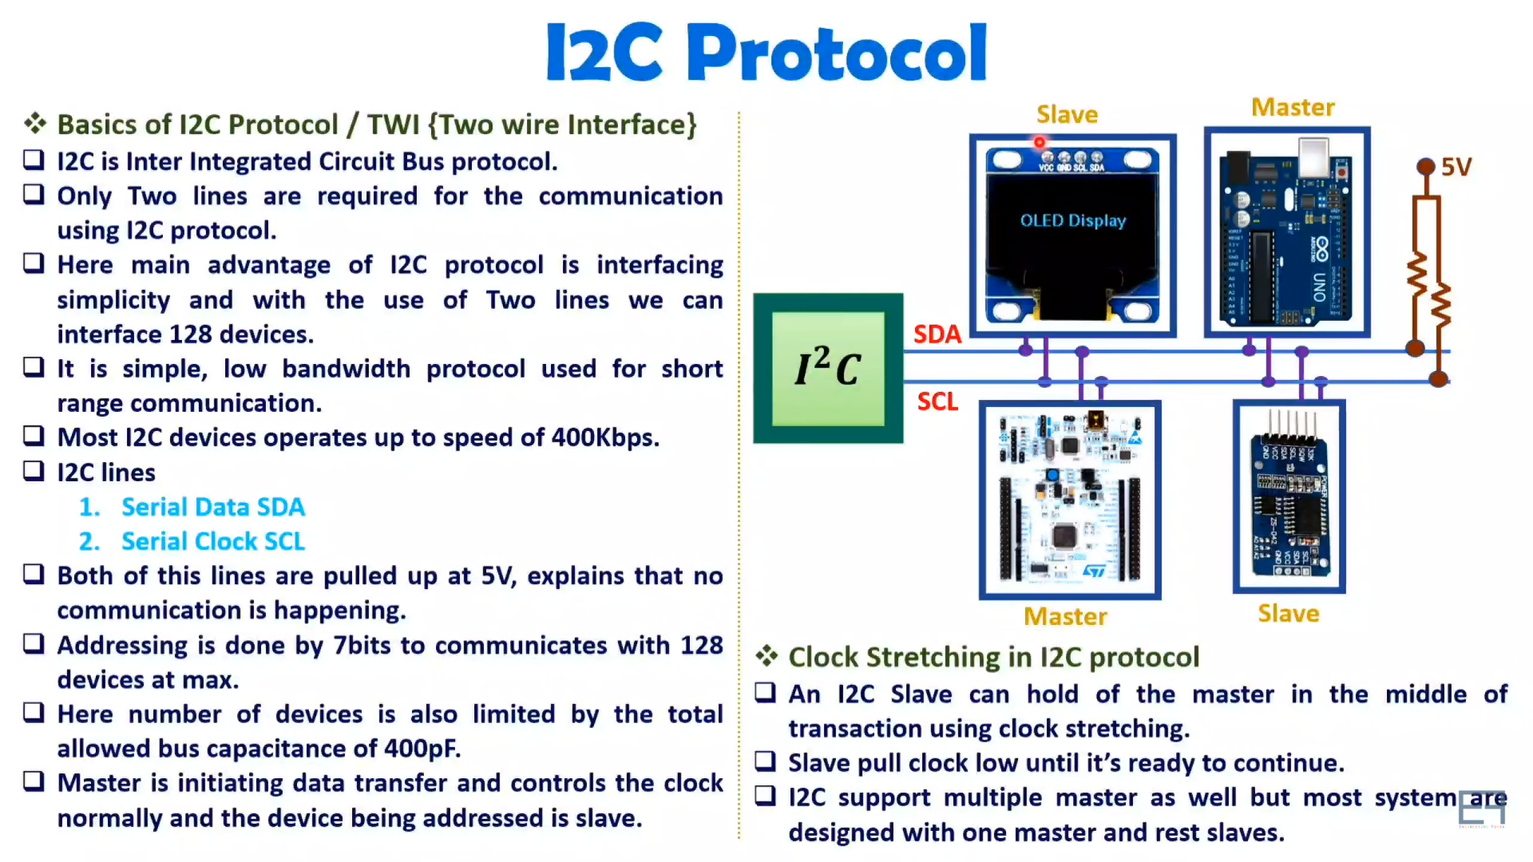

Slide 10
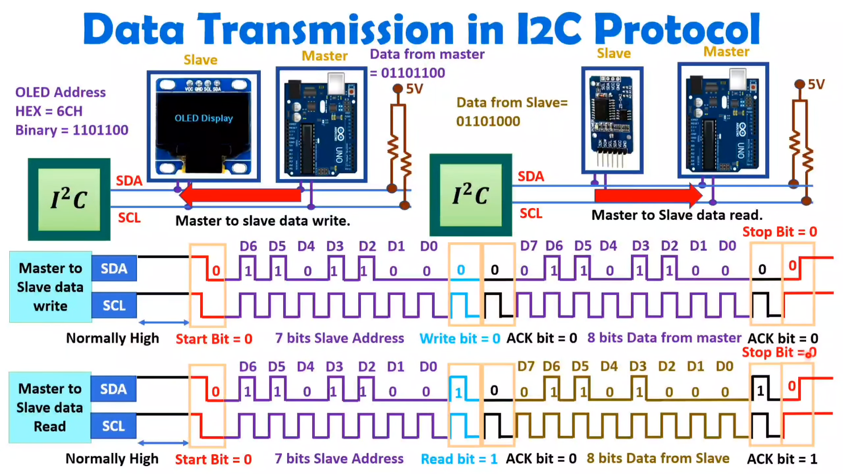

Slide 11
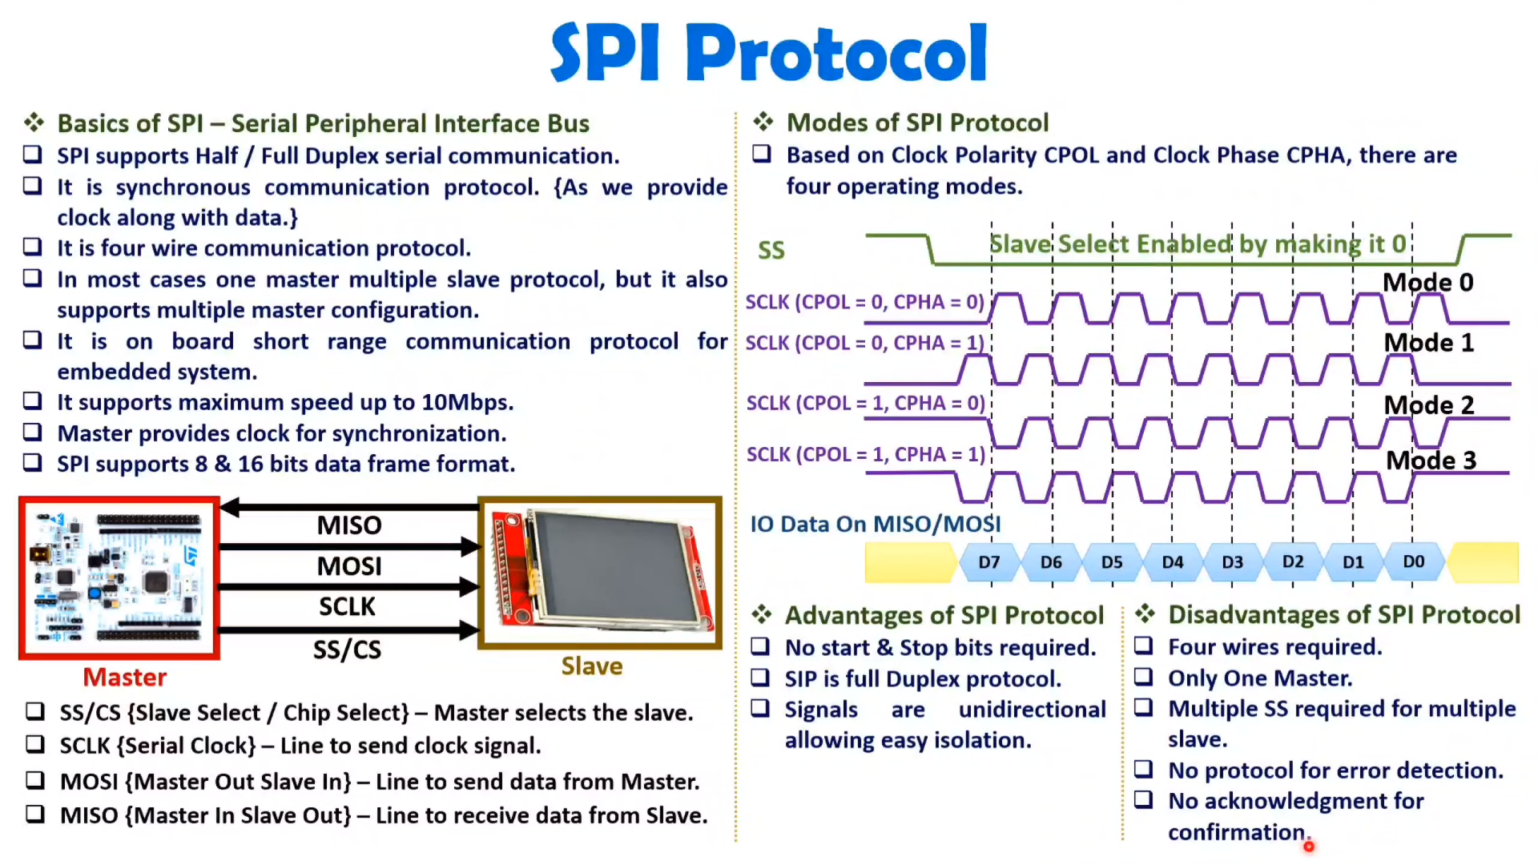

Slide 12
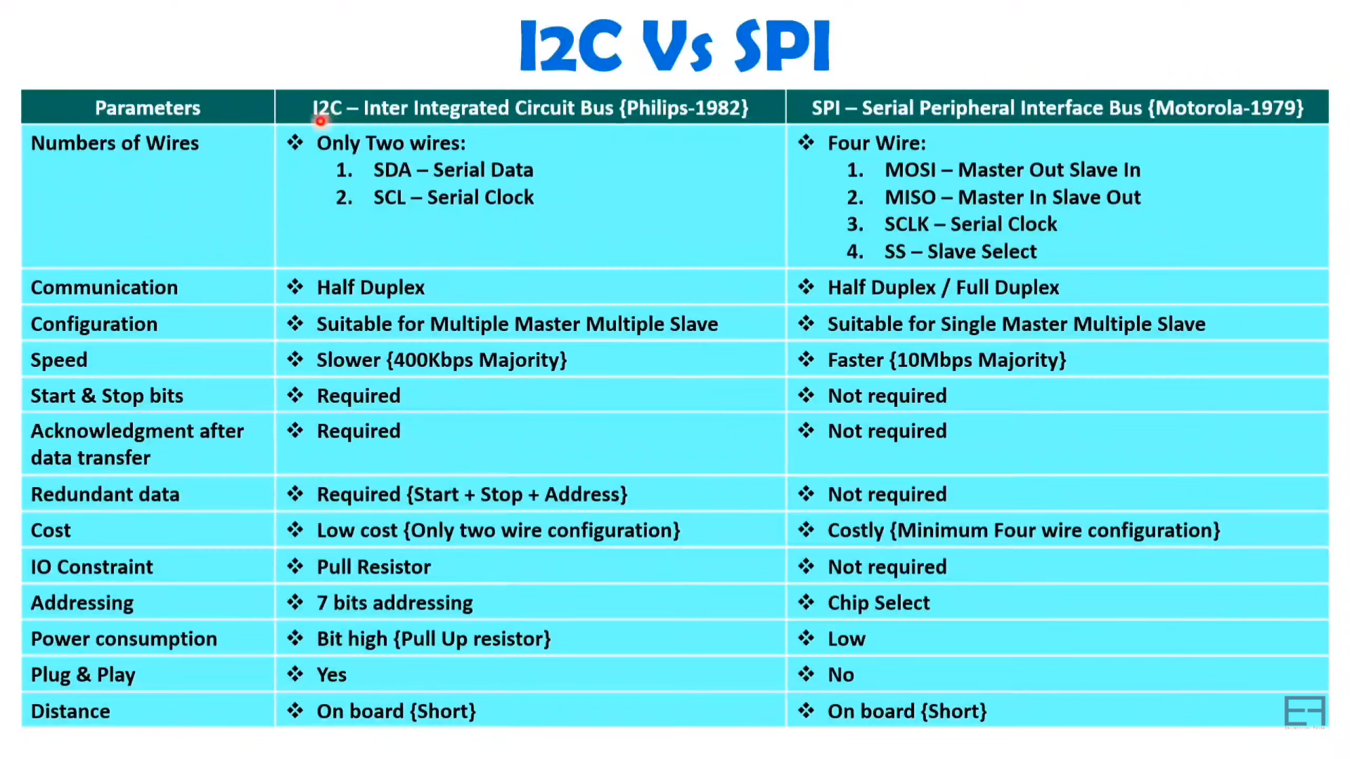

Slide 13
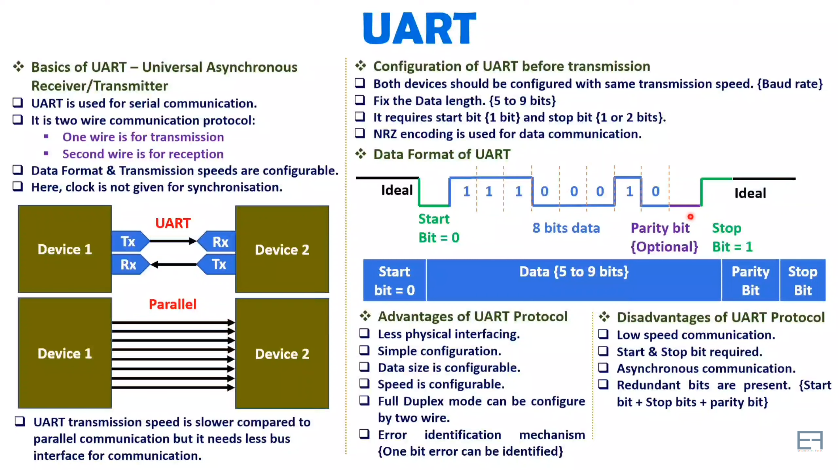

Slide 14
ADC: Analog to Digital Converter
It is an electronic component which converts analog signals to digital signals.
It involve of a 2 main steps:
Sampling of an analog signal -- How much sampling rate is required? Ans: Nyquist theorem stats Bandwidth of a signal -> 2*Sampling rate else it will show quantization error.
Quantization of an analog signal.

Slide 15
Watchdog Timer
It is used to reset the processor, but when?
Basically, WDT is connected with a processor and processor will periodically send a signal regarding its health to a WDT and it will monitor that.
If signal from the processor is not received by the WDT in predefined time, then it will understand that processor is misbehaving due to software or hardware bug.
So, it will reset it.

Slide 16
Real time clock
It basically gathers the data of all the components in real time and store in very detailed manner i.e. it will have data of a any components behavior with time, date, year etc.
So, its attached with almost every embedded systems to monitor and to take necessary steps to trigger or to terminate any process at real time for max accuracy and efficiency.

Slide 17
Timer
Timers in microcontrollers are a crucial component for many embedded systems applications that require precise timing or real-time control. They provide an accurate and reliable way to generate interrupts and measure time intervals, making them a fundamental part of microcontroller programming.

Slide 18
Pulse-Width Modulation
PWM stands for Pulse-Width Modulation, which is a method of digital signal processing used in microcontrollers to generate analog output signals. PWM signals are used to control the speed of motors, the brightness of LEDs, and other applications that require variable output voltages.
In a microcontroller, PWM signals are generated by output pins that are configured for PWM mode. These pins are connected to a timer/counter peripheral, which generates a series of pulses with a fixed frequency.

